Slide 1
Perinatal Practices, Experiences and Memories: Cooperation with Roma Women
Stereoculture: the art of listening
Workshop: Shared Authority
Tina Palaić, curator
Slovene Ethnographic Museum

Slide 2
Accessibility of Cultural Heritage to Vulnerable Groups
September 2013 – November 2015
six national museums and one gallery
funds: European Social Fund and the Ministry of Culture
Project objectives:
to train the members of vulnerable social groups for employment in museums
to increase the accessibility of cultural heritage with adapted technology as well as specific education programmes
to offer opportunities for education and training

Slide 3
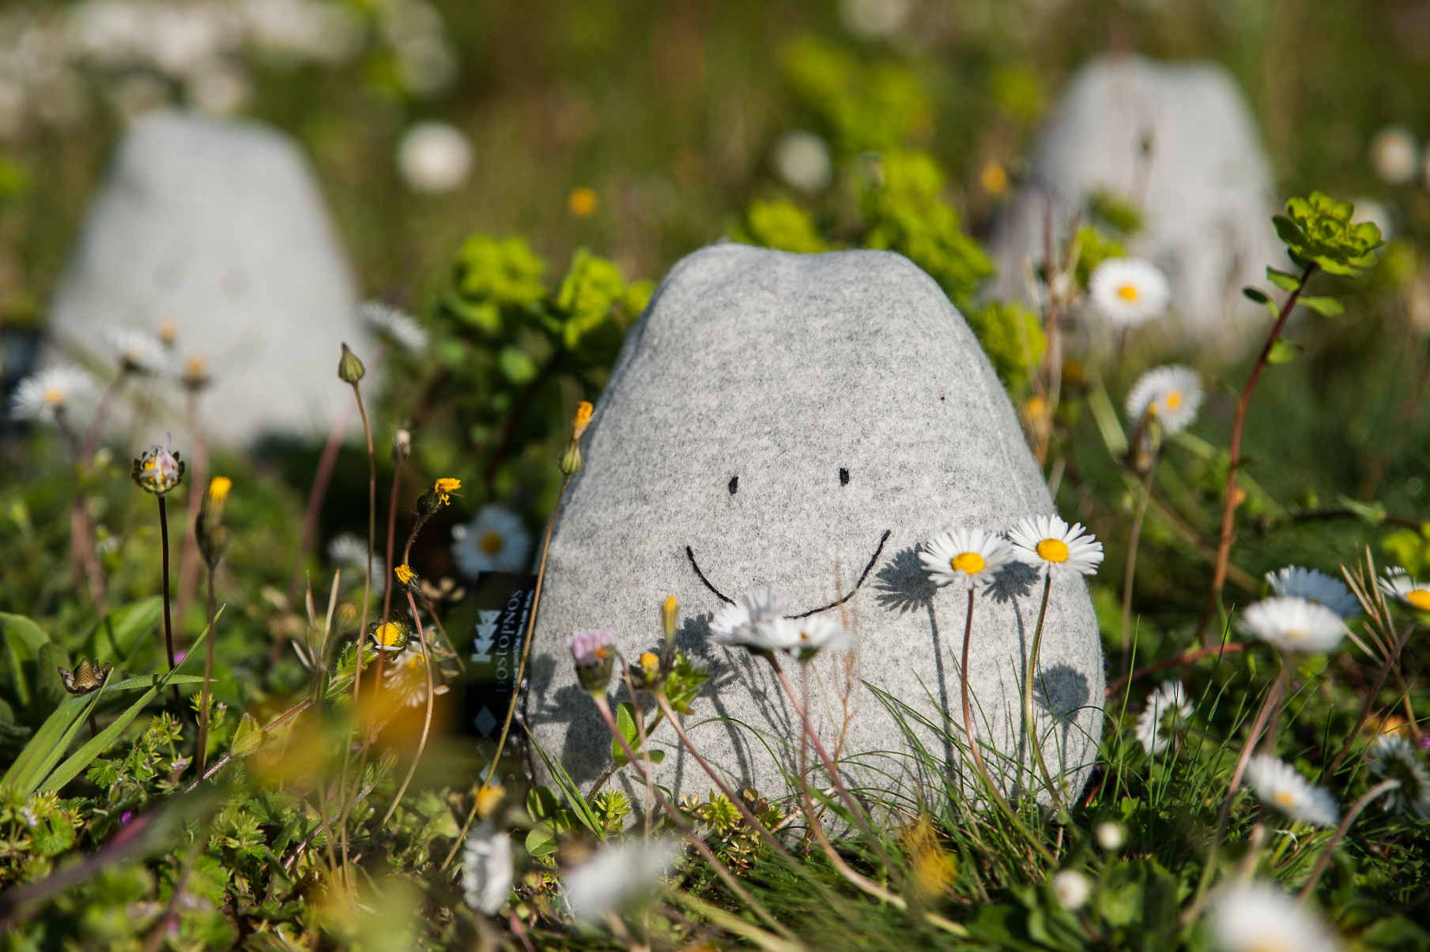

Slide 4
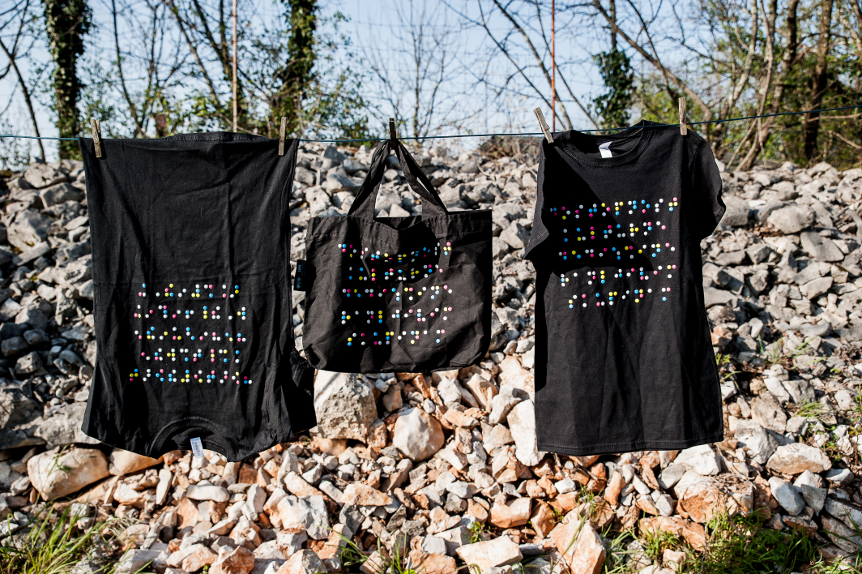

Slide 6
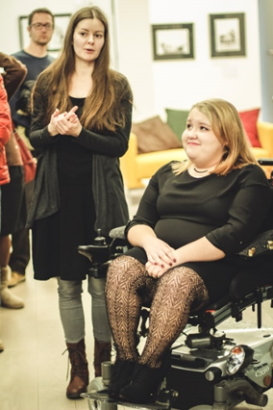
Vulnerable groups:
persons with reduced mobility,
persons with sensory impairment,
members of national minorities and ethnic communities in Slovenia,
immigrants,
young graduates – first-job seekers,
elderly unemployed people (55+)
The opening of the exhibition entitled Look at Me and You‘ll See in the Slovene Ethnographic Museum, prepared by Nastija Fijolič, highlighting the issues of body ideals in today‘s society.

Slide 7
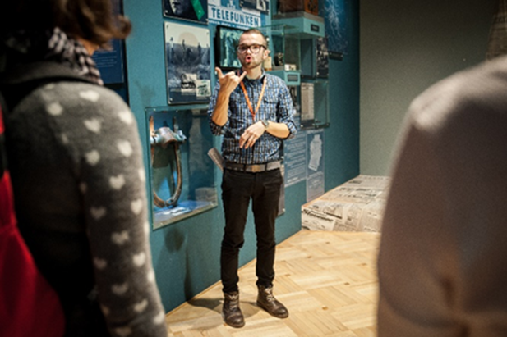
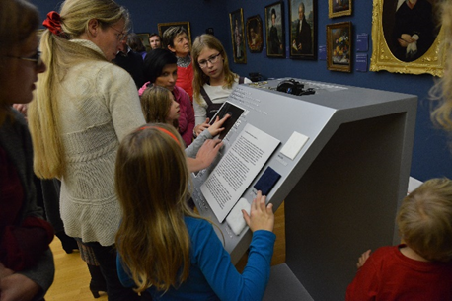
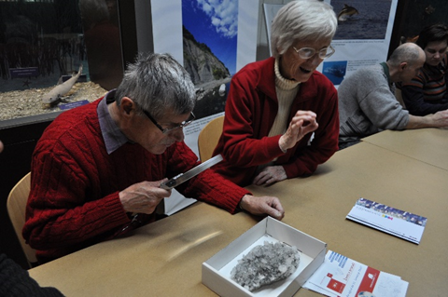
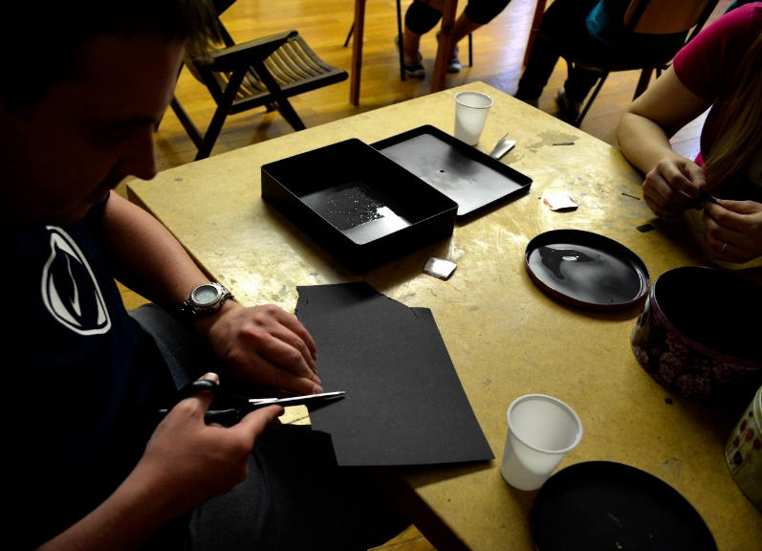
Gašper Rems, a deaf student, gave a tour of the exhibition in Slovene sign language.
Presentation of the tactile adjustment of Luiza Pesjak‘s portrait by Michael Stroj.
Visitors from the Deaf-Blind Association of Slovenia learned about various types of crystals.
The blind and visually impaired participants in the photographic workshop made their own camera obscuras and took photos of copies of museum objects.

Slide 8
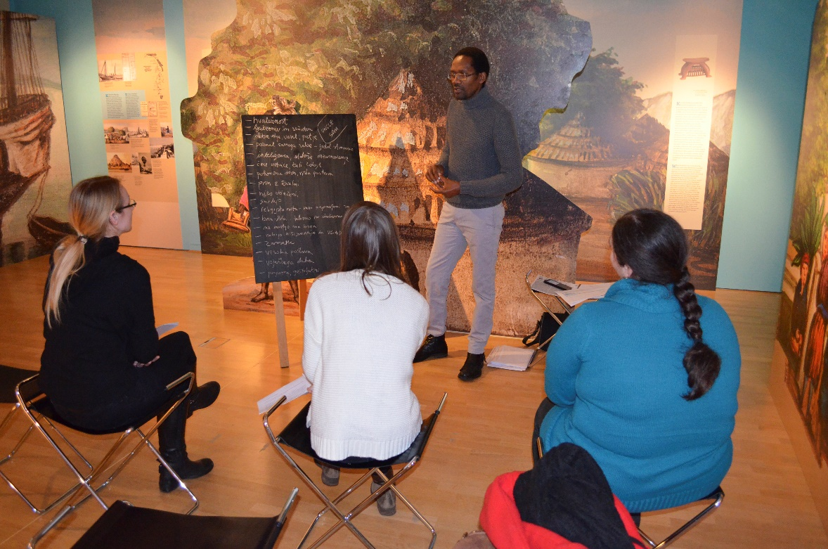
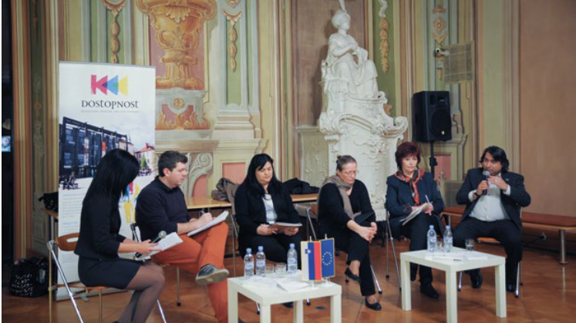
At the Encounters with Africas: From the 19th Century to the Present workshop, Max Zimani discussed the stereotypes about the Nilotic peoples encountered by the missionaries in the land of the Nile in the 19th century.
Porajmos – the Forgotten Past, discussion on the genocide against the Roma during the World War II.

Slide 9
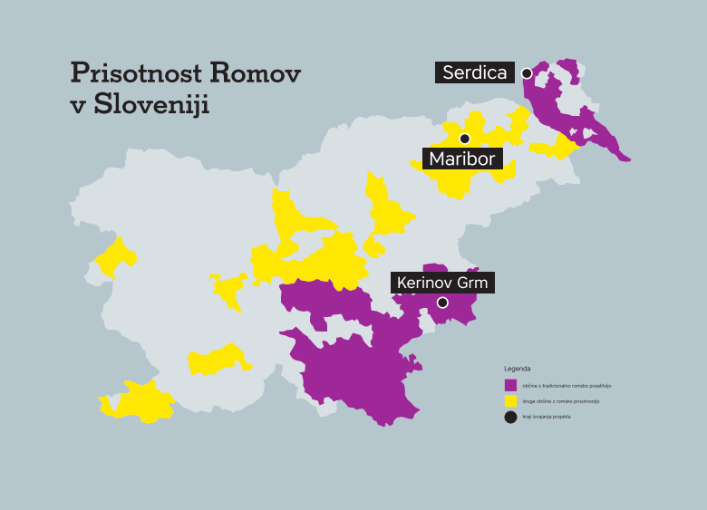
Birth: Experience of Roma Women
Roma Settlements Map

Slide 10
The Theatre of the Oppressed
Workshops with Roma Women

Slide 11
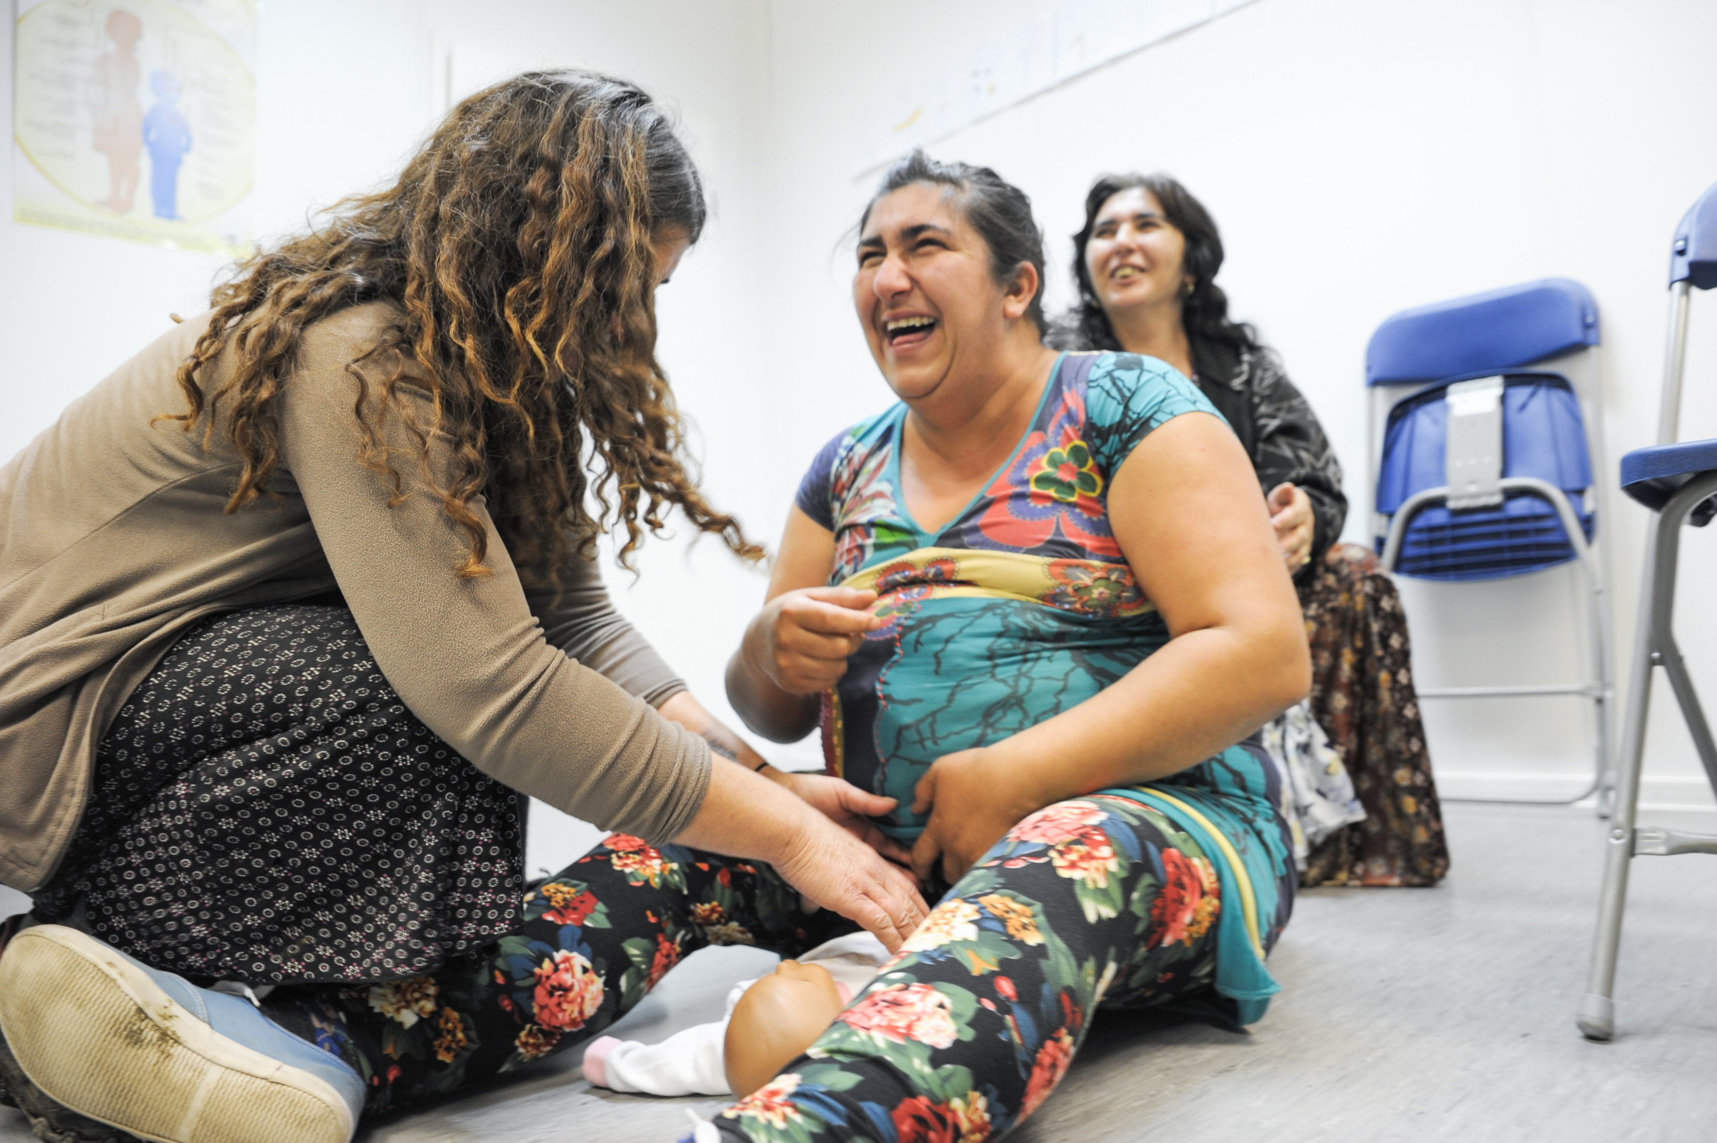

Slide 12
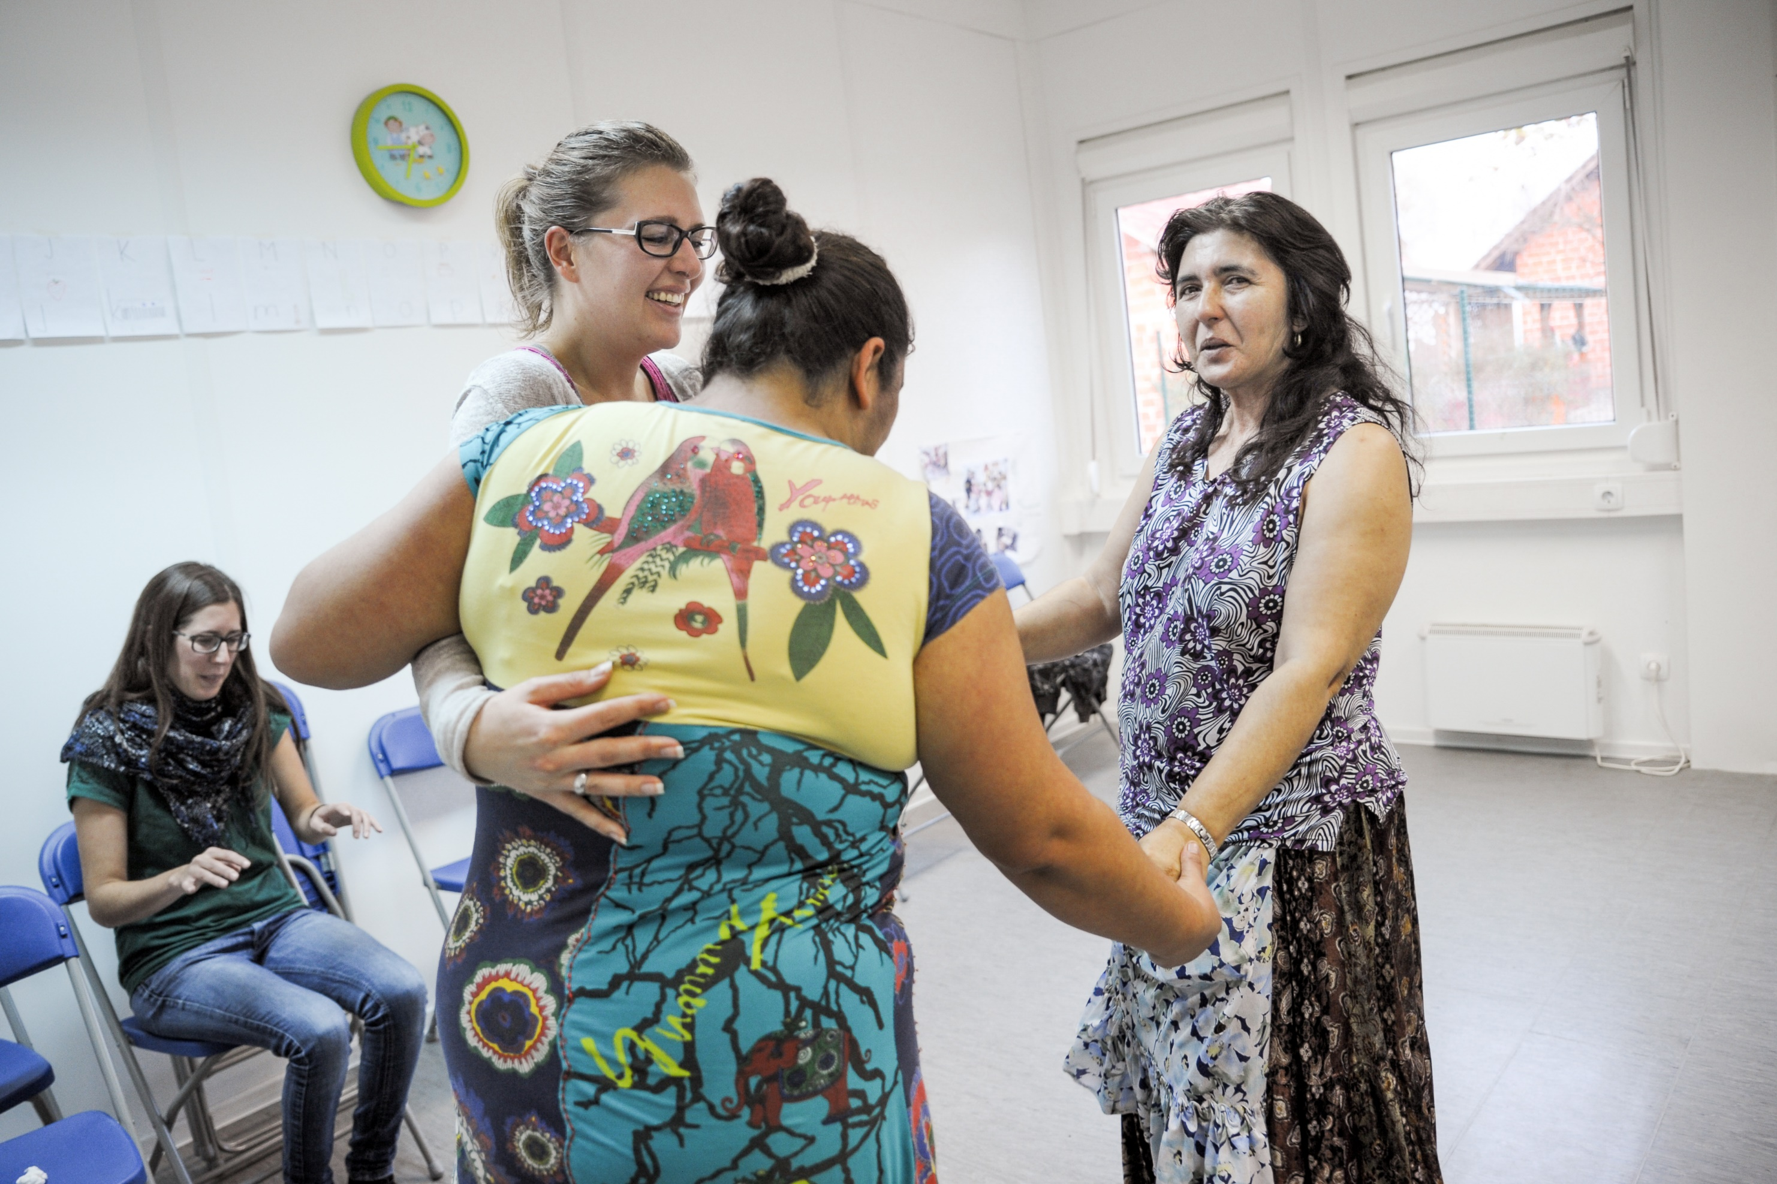

Slide 13
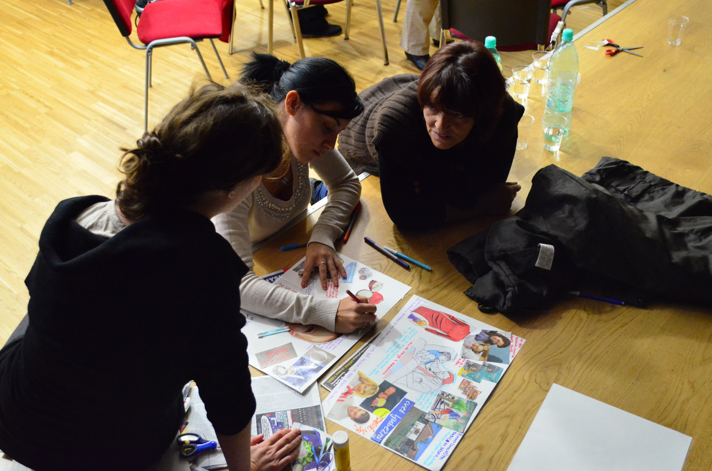

Slide 14
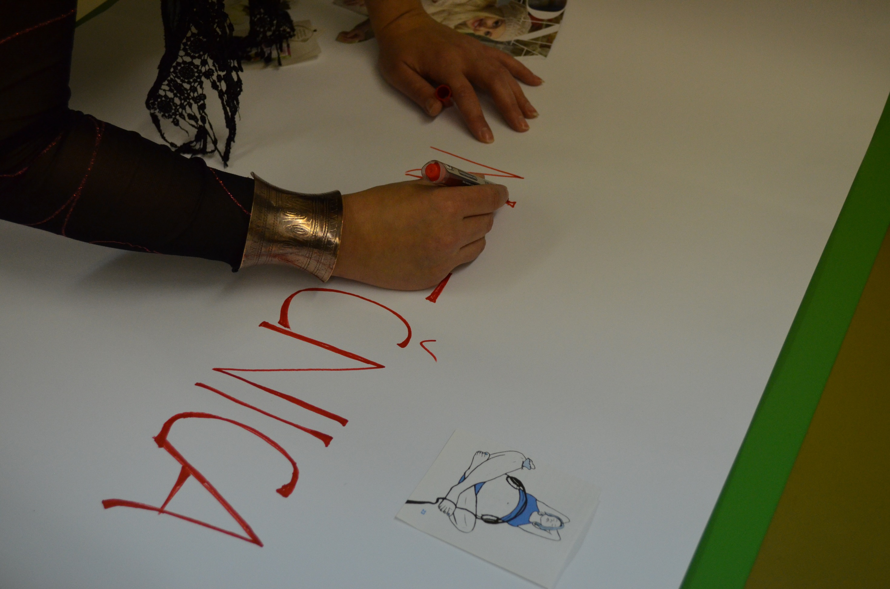

Slide 15
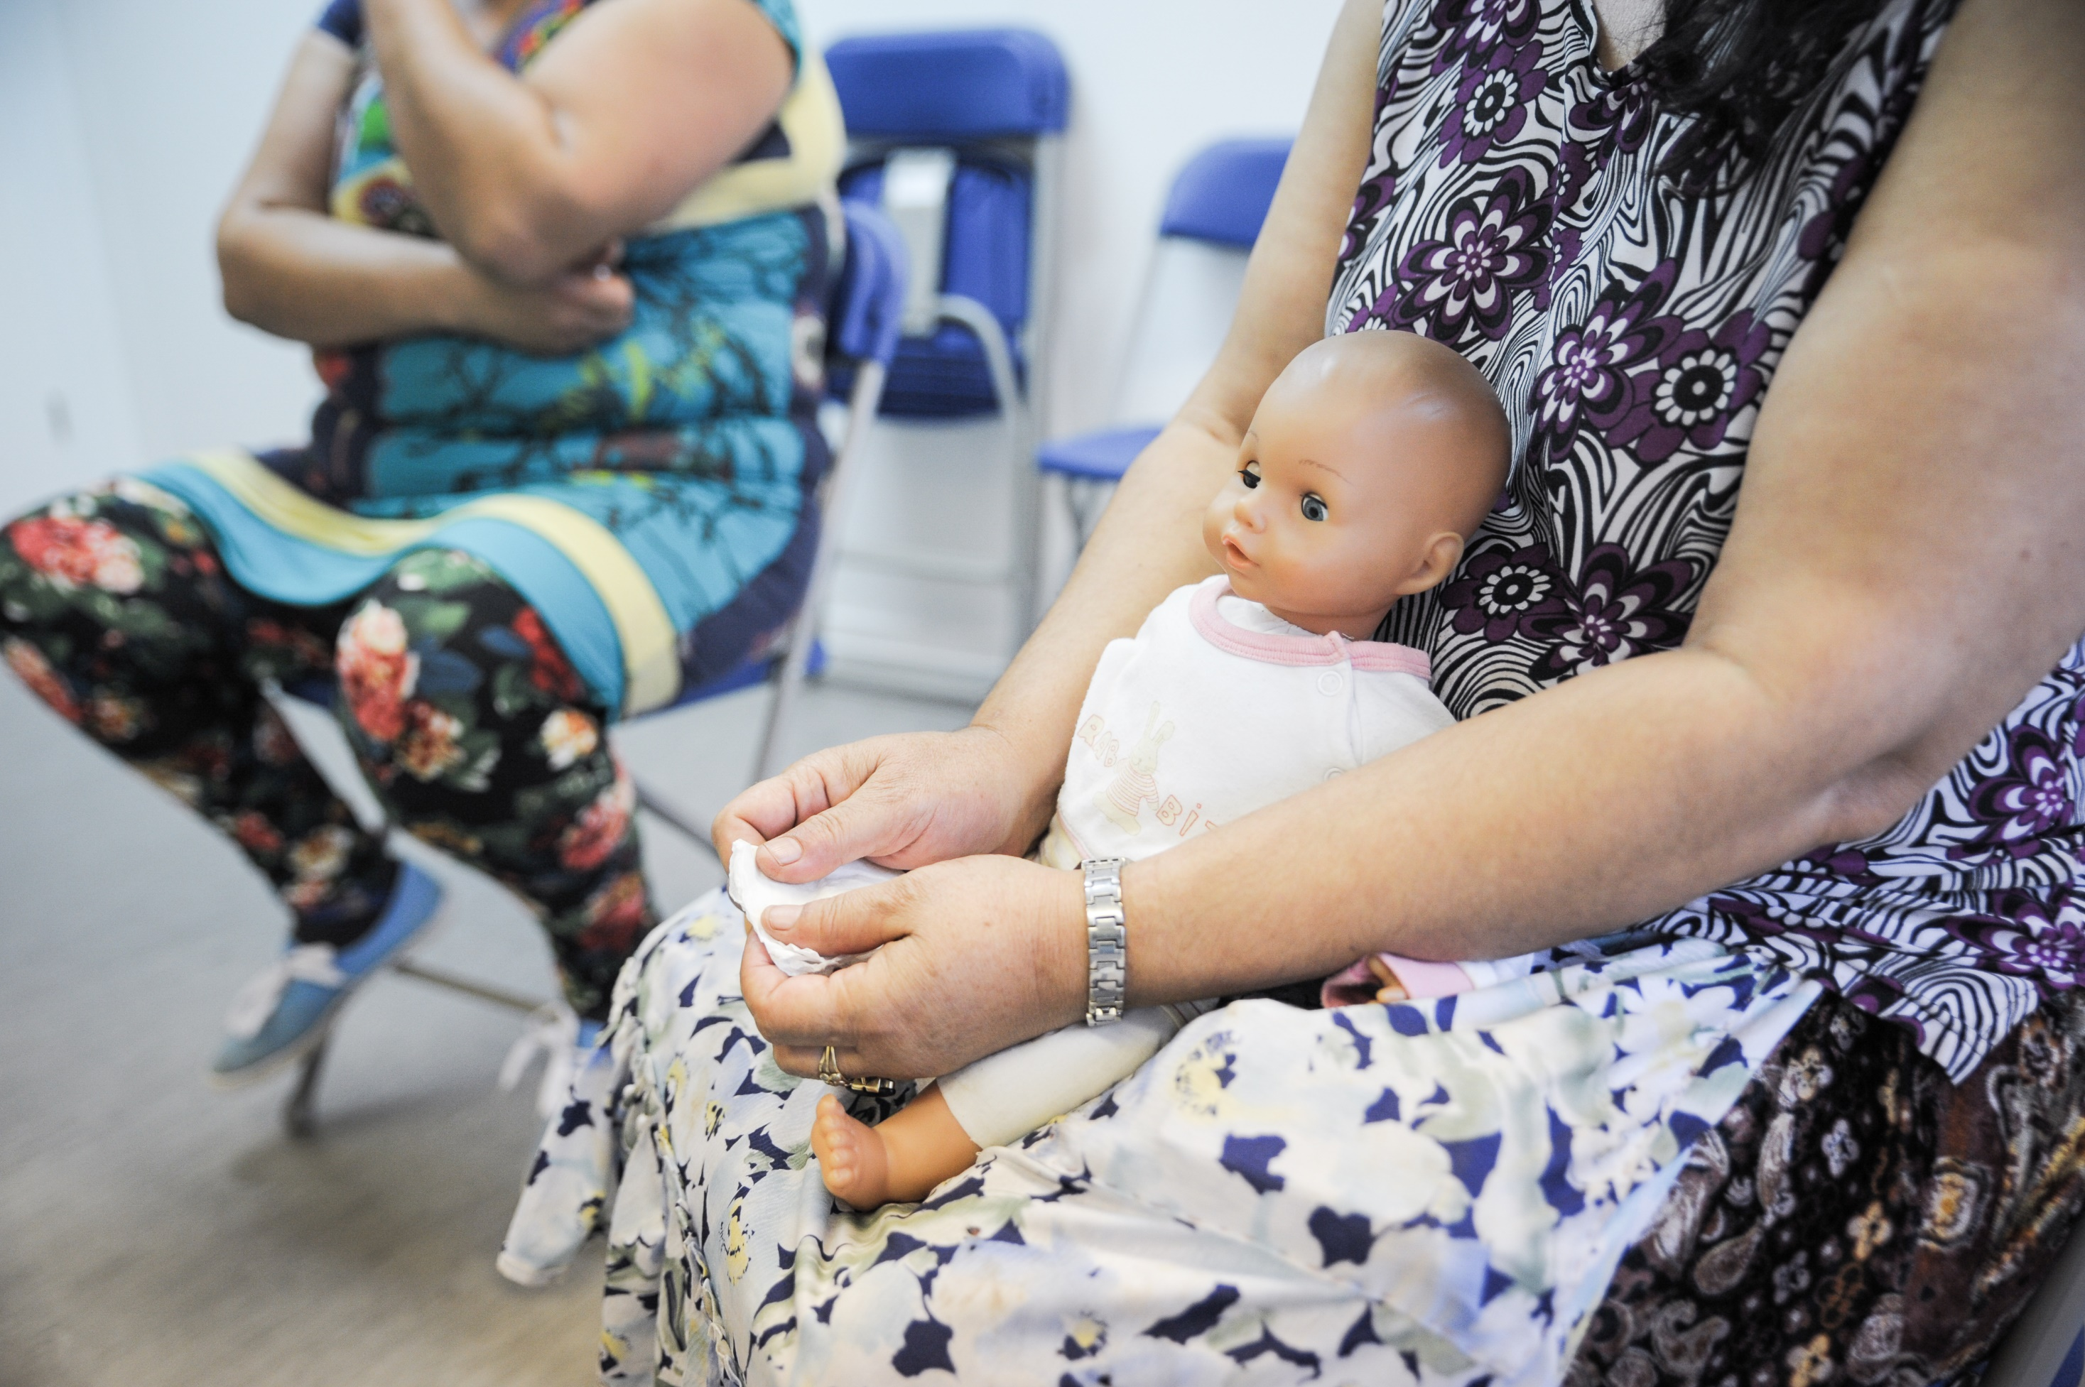

Slide 16
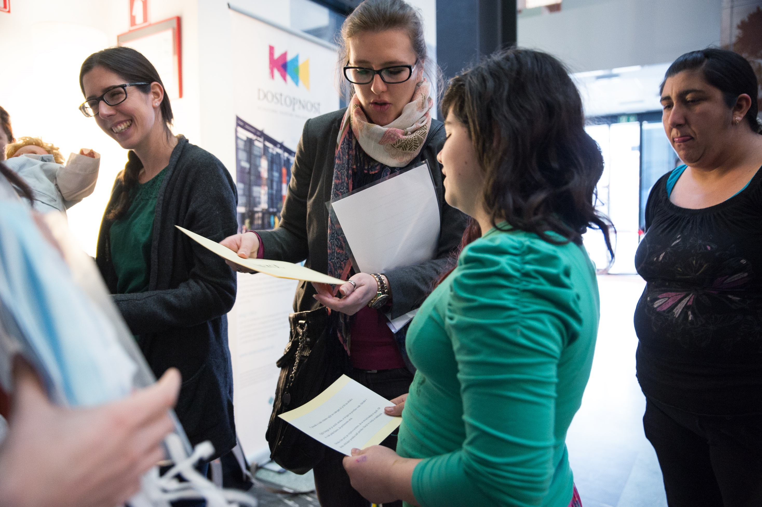

Slide 17
Birth: Experiences of Roma Women in Serdica
The Theatre Performance
Accessible on:
YouTube => channel Slovenski etnografski muzej => title Predstava: Rojstvo – Izkušnje Rominj
Link: https://www.youtube.com/watch?v=7lmLnmxbi3w

Slide 18
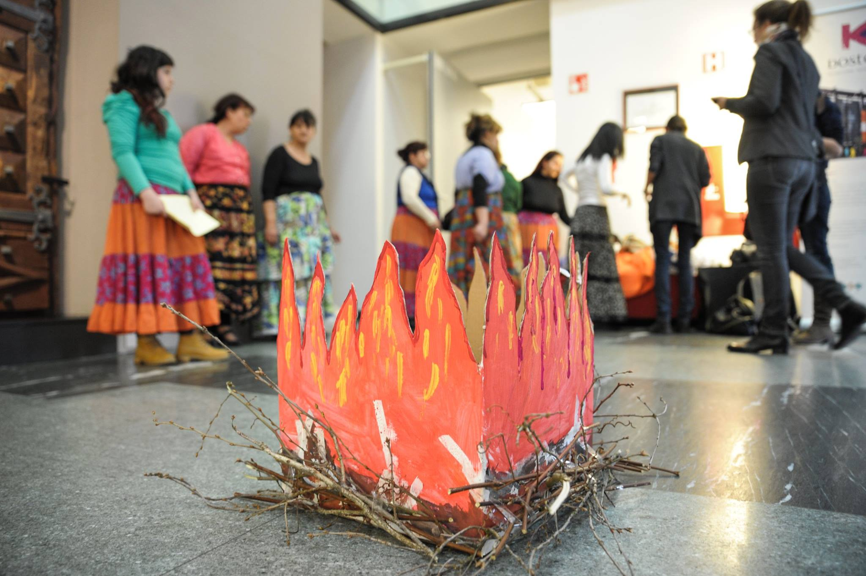

Slide 19
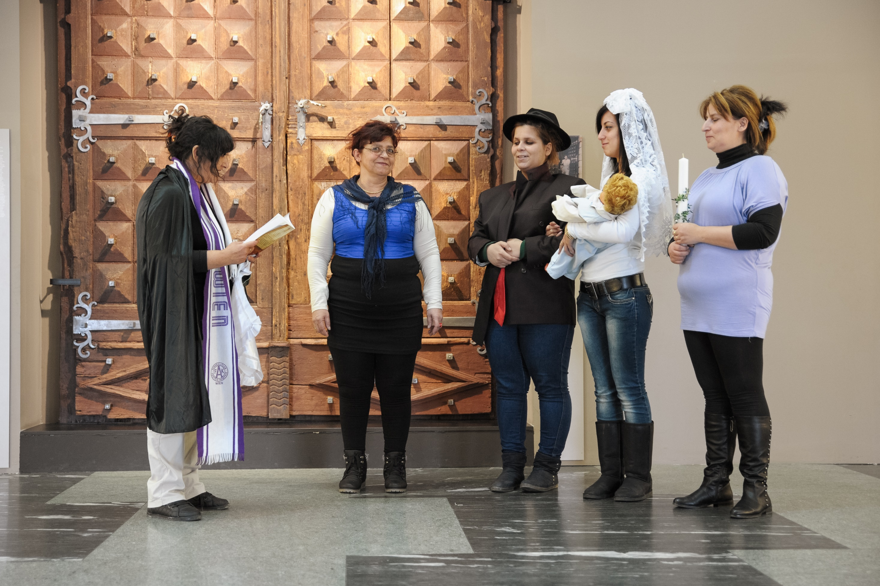

Slide 20
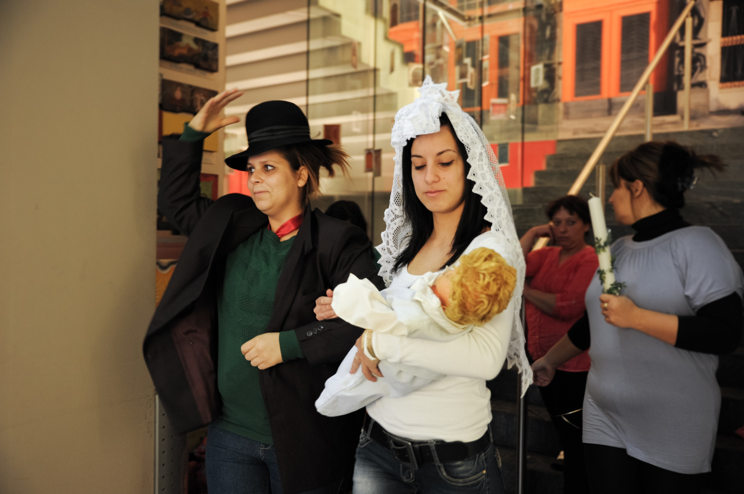

Slide 21
The Exhibition Birth: Experience of Roma Women

Slide 22
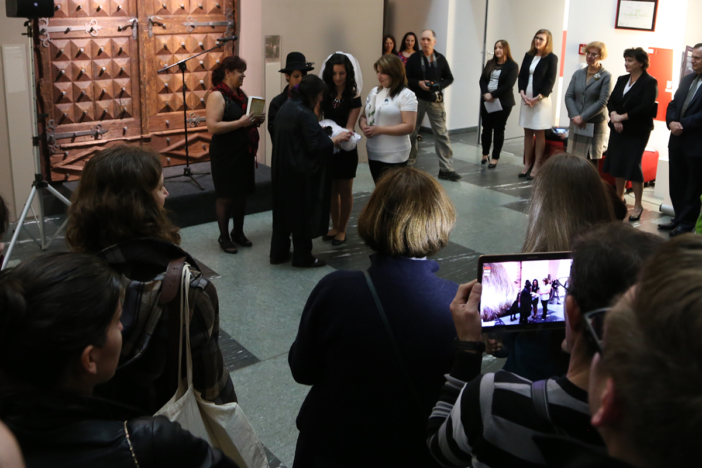

Slide 23
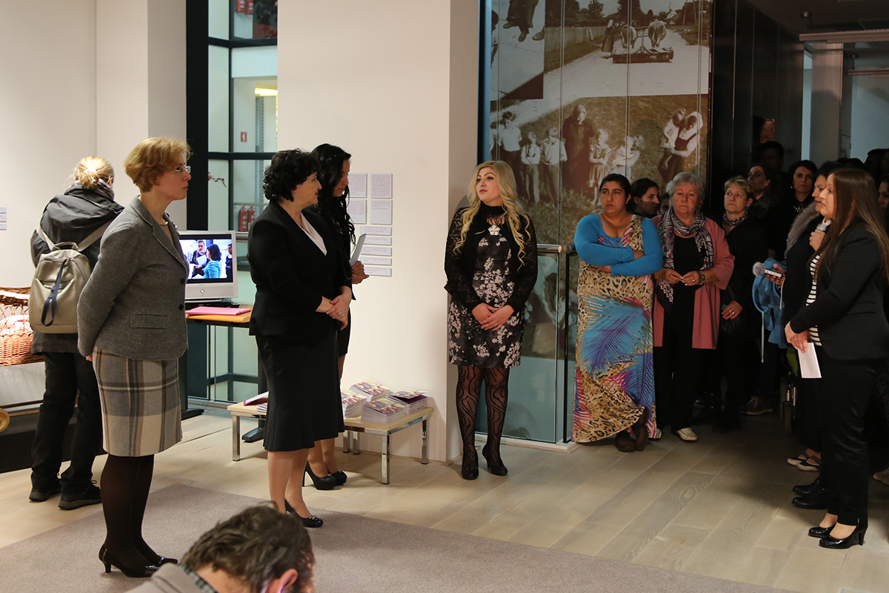

Slide 27
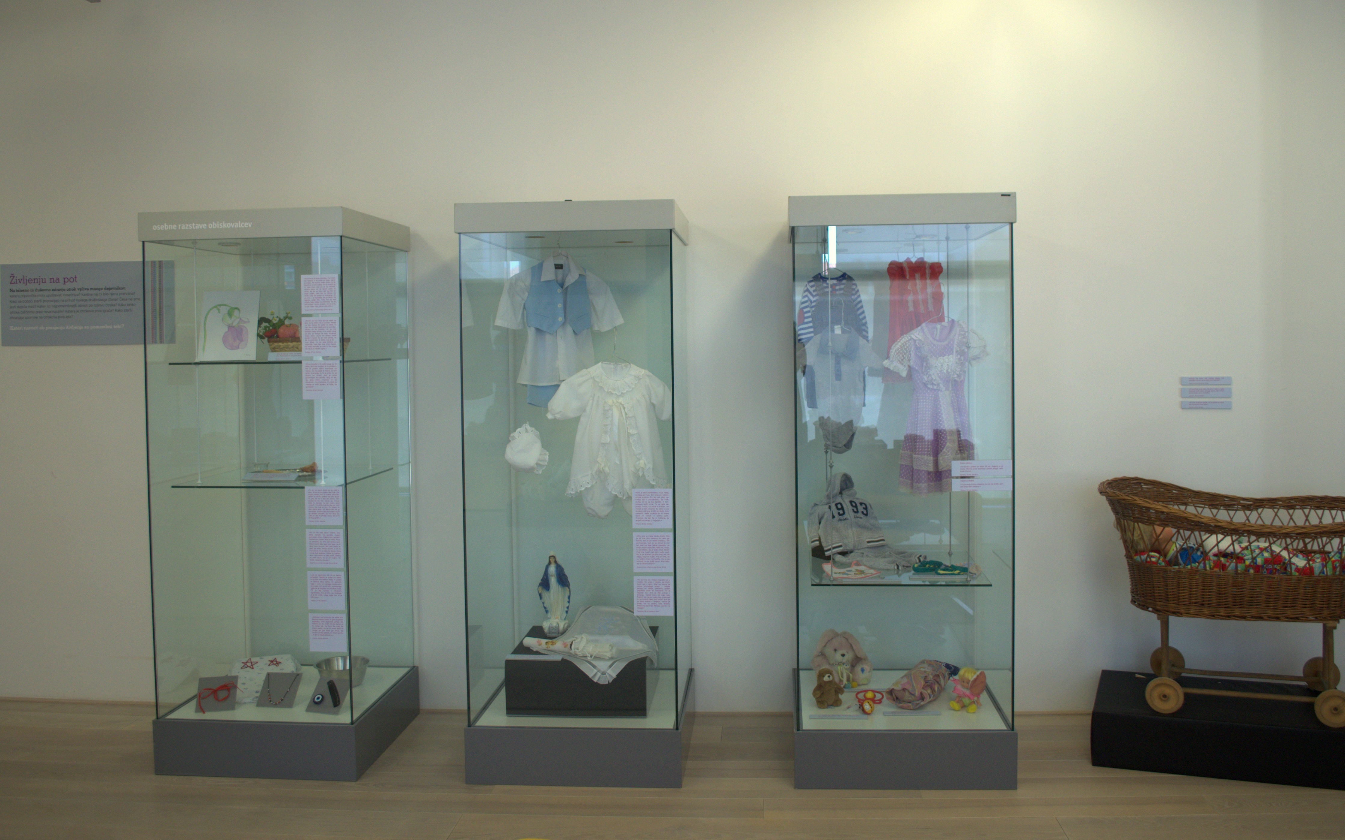

Slide 29
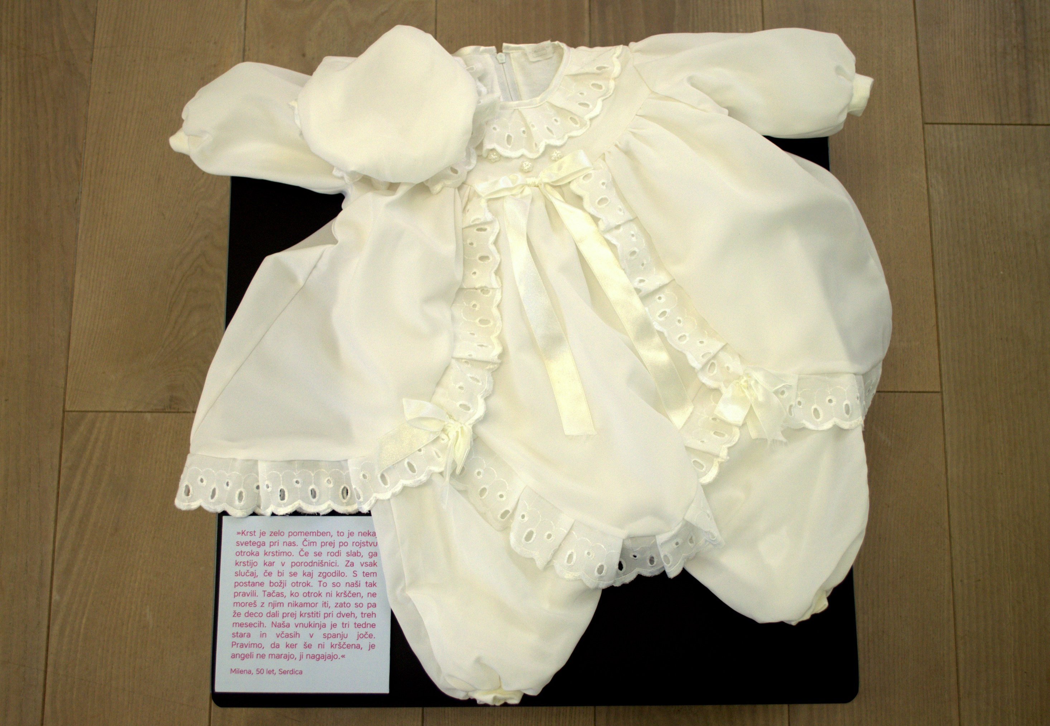

Slide 30
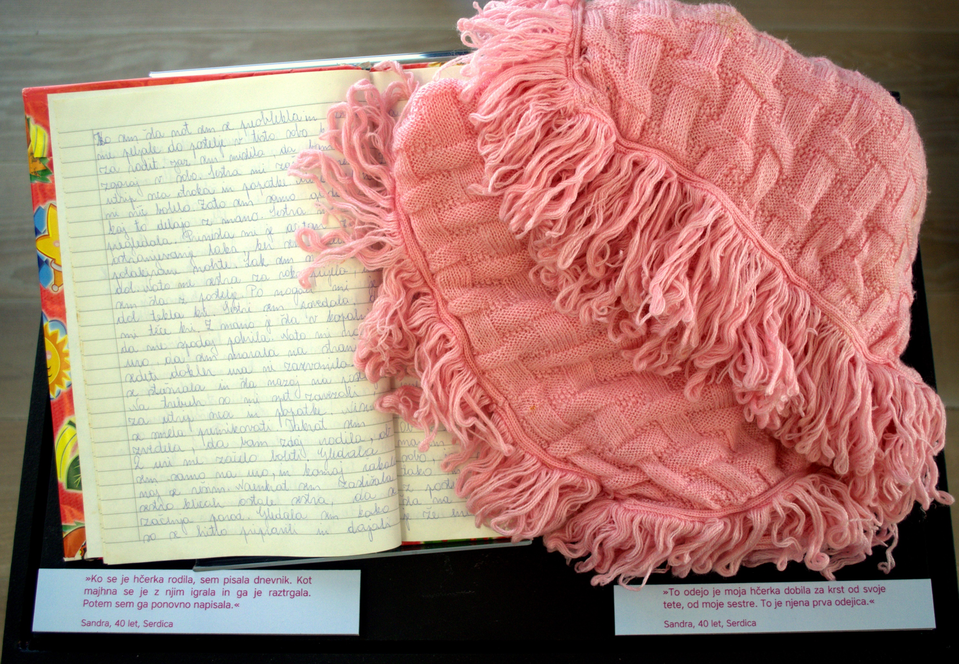

Slide 31
aMUSE(U)Ment
Link: https://amuseumentblog.wordpress.com

Slide 32
Tina Palaić tina.palaic@etno-muzej.si

