Slide 1
Collection Of The Missionary IGNACIJ KNOBLEHAR In The Past, Present And Future
SWICH Workshop: Historic Collections, Contemporary Lives
Cambridge, March 2017
Anja Koren & Marko Frelih, Slovene Ethnographic Museum

Slide 2
Portrait Of Missionary Ignacij Knoblehar.

Slide 3
Catholic priest Franz Morlang with Bari people at Gondokoro missionary station (today‘s Juba) in 1860.

Slide 4
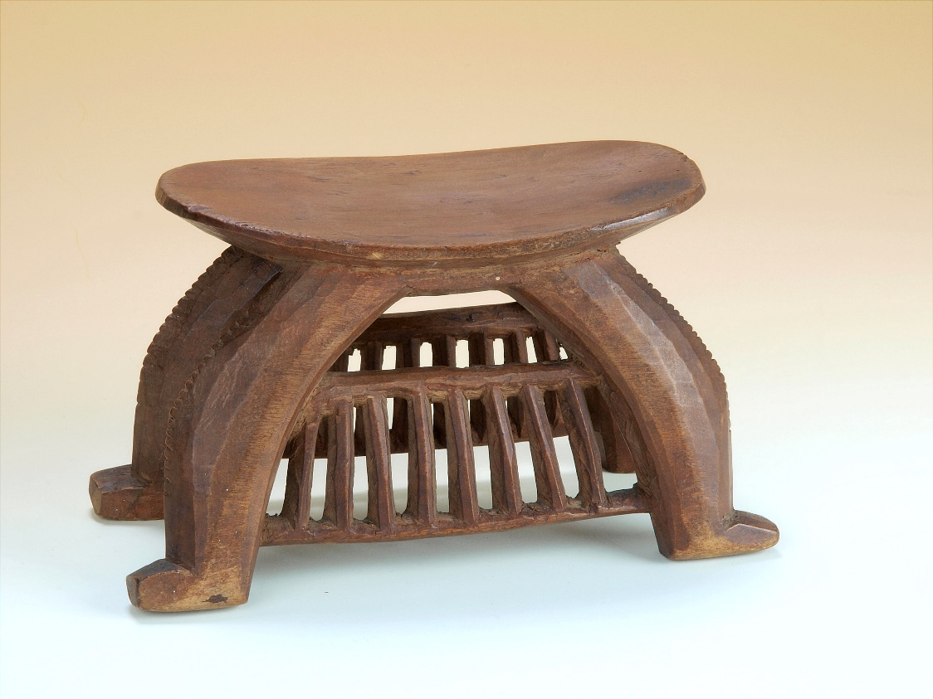
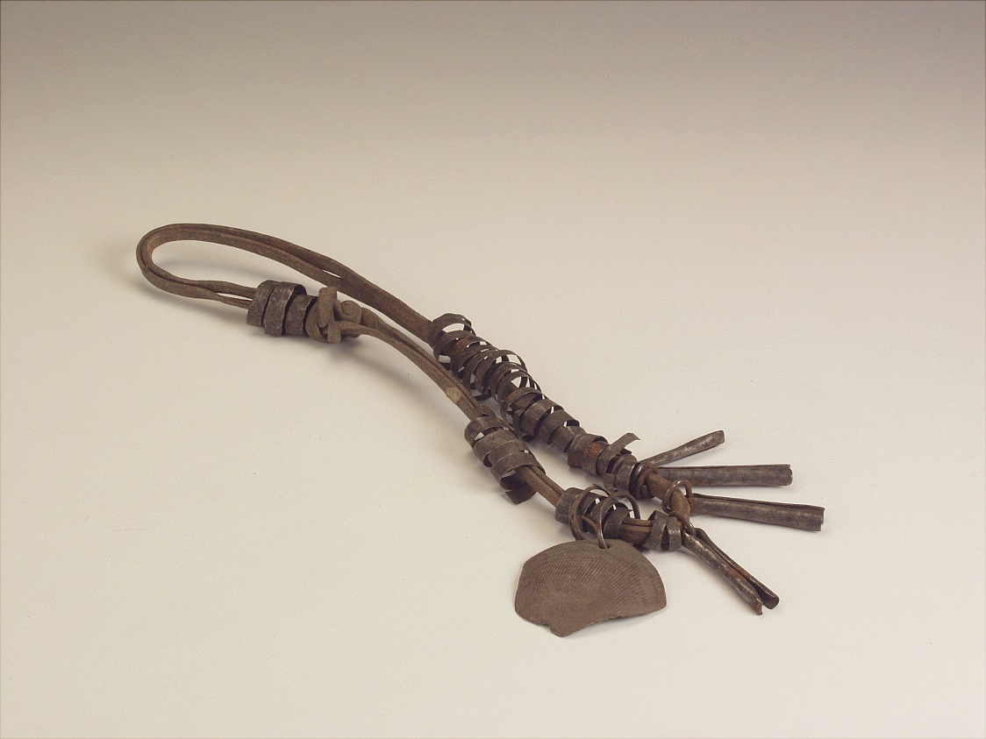
Stool and headrest carved from a single piece of wood (Knoblehar‘s collection).
Leather necklace with pendants (Knoblehar‘s collection).
Necklace with amulets – tortoise shell, gourd, claw and leather (Knoblehar‘s collection).

Slide 5
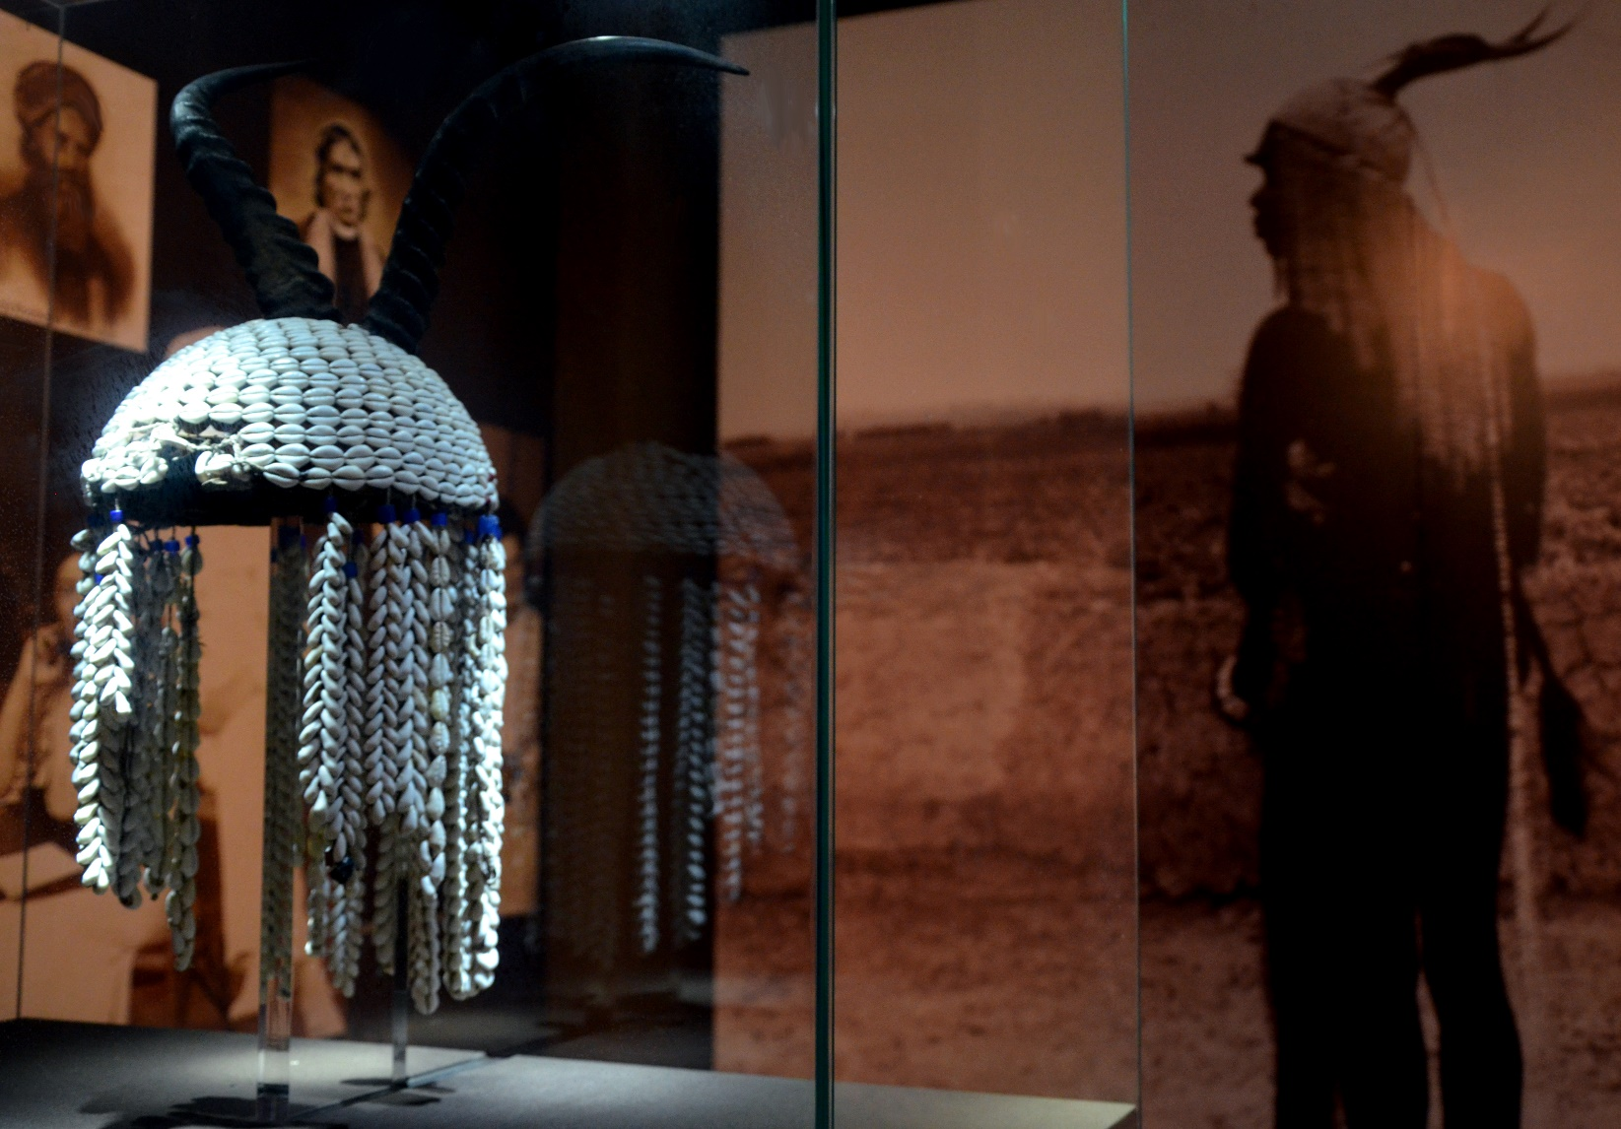
Spears from Knoblehar‘s collection and Knoblehar portrait presented at the permanent exhibition Between Nature and Culture in Slovene Ethnographic Museum.

Slide 6
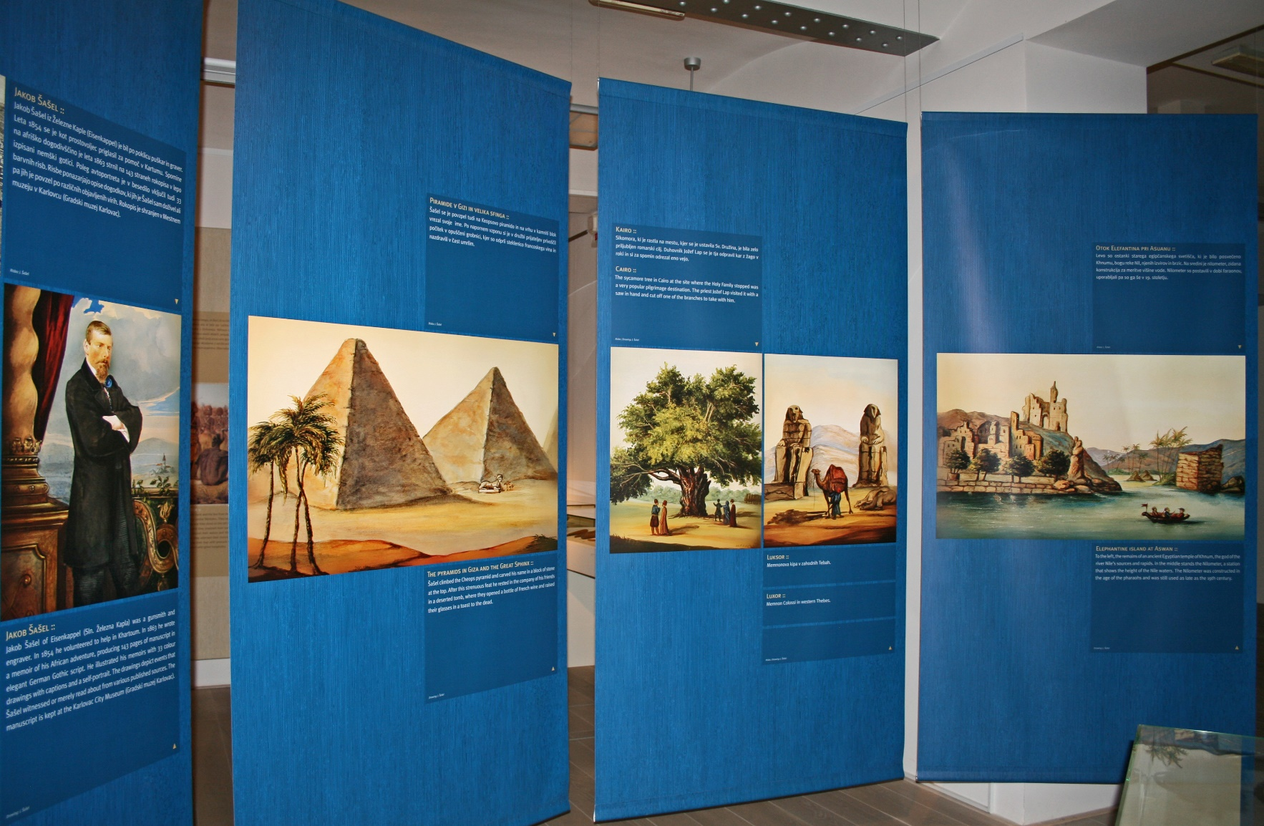
Exhibition Sudan Mission 1848 – 1858: Ignacij Knoblehar – Missionary, Explorer of the White Nile and Collector of African Objects (2009).

Slide 7
Exhibition catalogue Sudan Mission 1848 – 1858: Ignacij Knoblehar – Missionary, Explorer of the White Nile and Collector of African Objects (2009).

Slide 8
Škocjan village in Lower Carniola where Ignacij Knoblehar was born.

Slide 9
Year 2019 – 200th Anniversary of Knoblehar‘s Birth
Slovene Ethnographic Museum
exhibition where Knoblehar‘s objects will be presented with the focus on the territory, where Knoblehar was working and on the Nilotic people among which he worked in parallel with today‘s situation and conditions in this region

Slide 10
Year 2019 – 200th anniversary of Knoblehar‘s birth
Local community of Škocjan
establishing of multi-cultural center of Ignacij Knoblehar
exhibition about Knoblehar‘s connection with the White Nile
collaboration between municipality of Škocjan, parish of Škocjan, pupils from local kindergarten and primary school, interested local residents and Slovene ethnographic museum
establishing of a webpage about Ignacij Knoblehar, where all the material will be collected in one spot – to attract younger generations

Slide 11
Old parson‘s house – new multi-cultural centre in Škocjan. This building needs to be fully renovated.

Slide 12
Statue and memorial plaque of Ignacij Knoblehar in his birth place Škocjan.
Every year local community of Škocjan celebrates municipal holiday called „Knobleharjevo“ through the cultural festival with concerts, lectures, performances, etc.

Slide 13
Year 2019 – 200th anniversary of Knoblehar‘s birth
Local community of Škocjan
establishing of multi-cultural center of Ignacij Knoblehar
exhibition about Knoblehar‘s connection with the White Nile
collaboration between municipality of Škocjan, parish of Škocjan, pupils from local kindergarten and primary school, interested local residents and Slovene ethnographic museum
establishing of a webpage about Ignacij Knoblehar, where all the material will be collected in one spot – to attract younger generations

Slide 14
Year 2019 – 200th anniversary of Knoblehar‘s birth
South Sudan Museums Network – connecting the arts and heritage of South Sudan in European Museums
from May 2017 to August 2018
based at Durham University
Participants: different European museums, participants from South Sudan‘s academic and heritage community, non-governmental organisations working on culture and civil society in South Sudan and academics with specialist knowledge

Slide 15
Is this enough to attract and please different audiences of today?
Anja Koren, ethnologist and cultural anthropologist
anja.koren@etno-muzej.si
Marko Frelih, PhD., curator for African and American collections
marko.frelih@etno-muzej.si

